Slide 1






DOMAIN-SALESFORCE DEVELOPER USECASE-CRM APPLICATION THAT HELPS TO BOOK A VISA SLOT
TEAM MEMBERS MENTOR :VENKATA RAMANEN B
DHANUSHYA D GUIDE : VENKATA RAMANEN B
PRIYADHARSHINI P EVALUATOR: VENKATA RAMANEN B
SHAMYUKTHA P
SRIJANANI JS

Slide 2
WHAT IS SALESFORCE ?
Salesforce is a leading cloud-based CRM platform, offering tools for sales, service, and marketing, empowering organizations with customer-centric solutions.
It provides scalable and customizable CRM software, streamlining customer data management, automating tasks, and driving business growth .
Salesforce’ s cloud architecture allows real-time data access, fostering collaboration, insights, and productivity across various industries and business sizes.

Slide 3
CRM APPLICATION THAT HELPS TO BOOK A VISA SLOT
A visa slot management project is a system that is used to track and manage the availability of visa slots, which are appointments that are required for certain visa applications.
It might be used by a government agency or a visa processing center to schedule and manage appointments with applicants

Slide 4
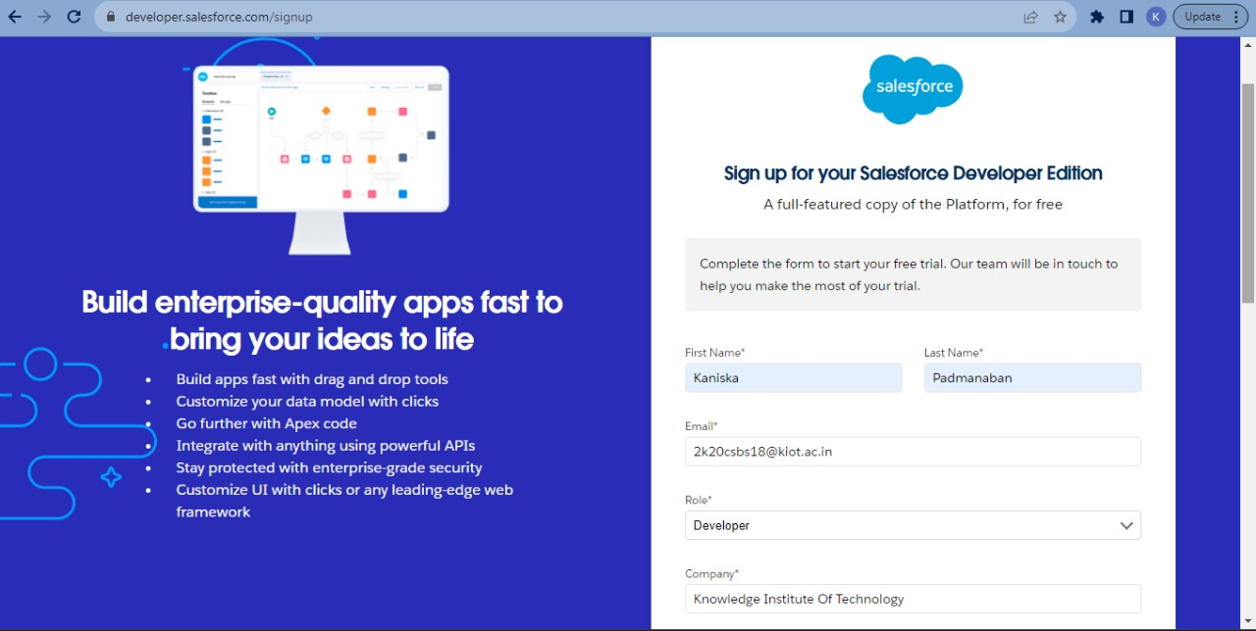
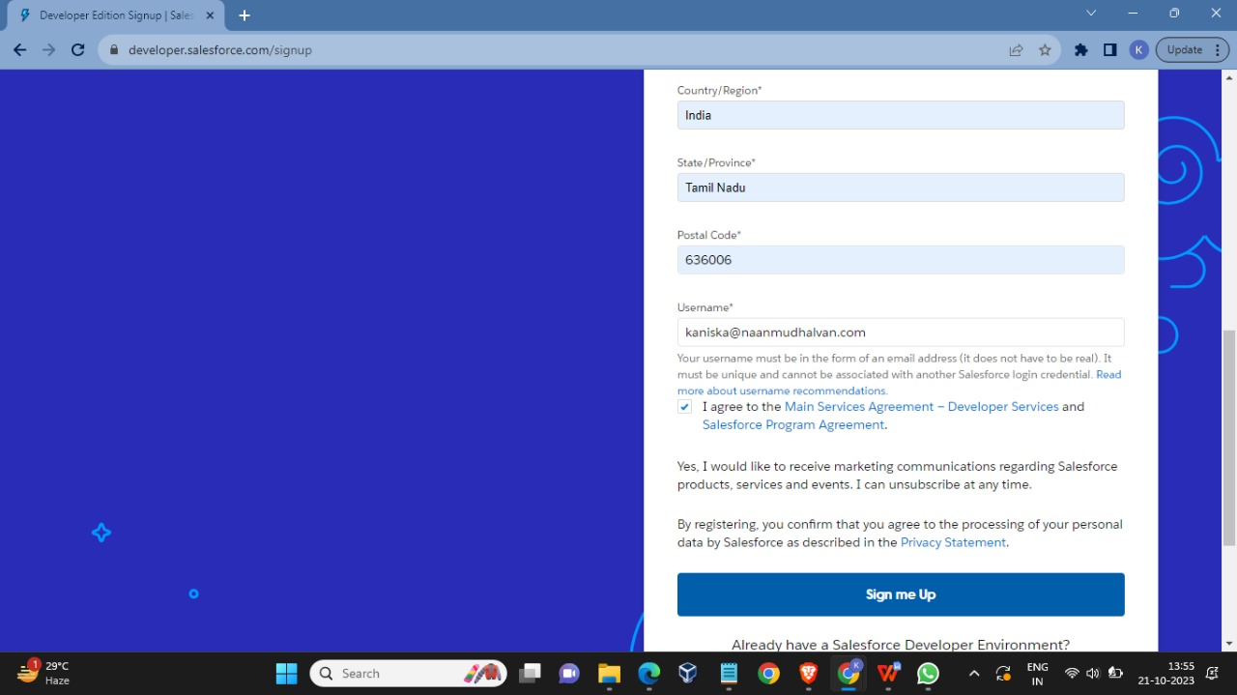
CREATION OF DEVELOPER ACCOUNT A Developer org has all the features and licenses you need to get started with Salesforce.1.Search Developer.salesforce.com/signup

Slide 5
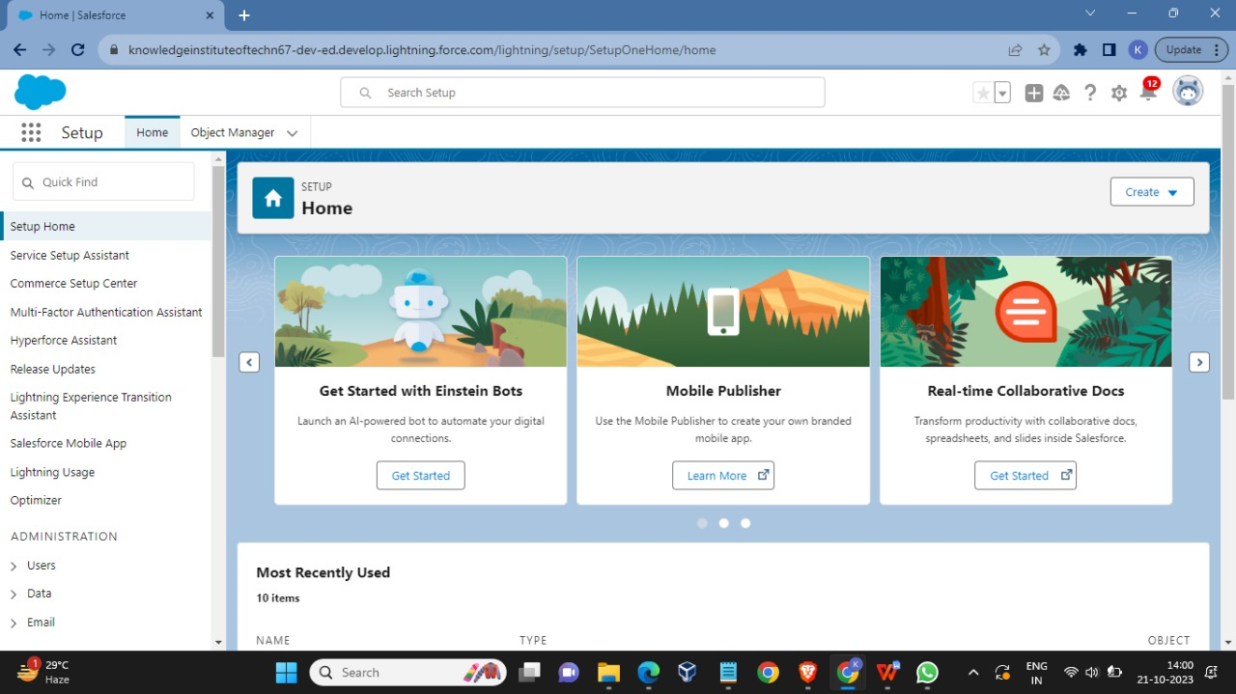
HOME PAGE

Slide 6
OBJECTS
WHAT IS AN OBJECT?
Salesforce objects are database tables that permit you to store data that is specific to an organization. It consists of fields (columns) and records (rows).
SALESFORCE OBJECTS ARE OF 2 TYPES
Standard Objects: Standard objects are the kind of objects that are provided by salesforce.com such as users, contracts, reports, dashboards, etc.
Custom Objects: Custom objects are those objects that are created by users. They supply information that is unique and essential to their organization. They are the heart of any application and provide a structure for sharing data.

Slide 7

In This Application We Use 3 Custom Objects:
Creation of custom Object Passport
Creation of custom object visa slot
Creation of custom object payment

Slide 8
TABS
Tabs in Salesforce help users view the information at a glance. It displays the data of objects and other web content in the application.
There are mainly 3 types of tabs:
Tab-Passport object :
Tab-Passport object stores passport information for visa applicants, including passport number, issue date, expiration date, and relevant personal details.
Tab-Visa Slot object:
Tab-Visa Slot object manages appointment slots, tracking consulate/embassy, availability, booking status, and relevant details for visa applicants.
Tab-Payment object:
Tab-Payment object records payment data, including transaction amount, method, status, and reference details for visa application fees.

Slide 9
RELATIONSHIP BETWEEN OBJECTS
Relationship in Salesforce is a 2-way association between 2 objects. Using relationships, we can link objects with each other and we can make connections and display data about other related objects.
Primarily there are two types of relationships:
Master detail relationship
Look up relationship

Slide 10
Master detail relationship:
A master-detail relationship defines the relationship between the parent and the child. The master table defines the parent relation and the detail defines the child relation. If the master table is deleted then the child record data is also deleted.
Look up relationship:
Lookup Relationship in Salesforce links two objects together but has no effect on deletion or security. To Create a Master-Detail relationship between Passport and Visa Slot Objects.

Slide 11
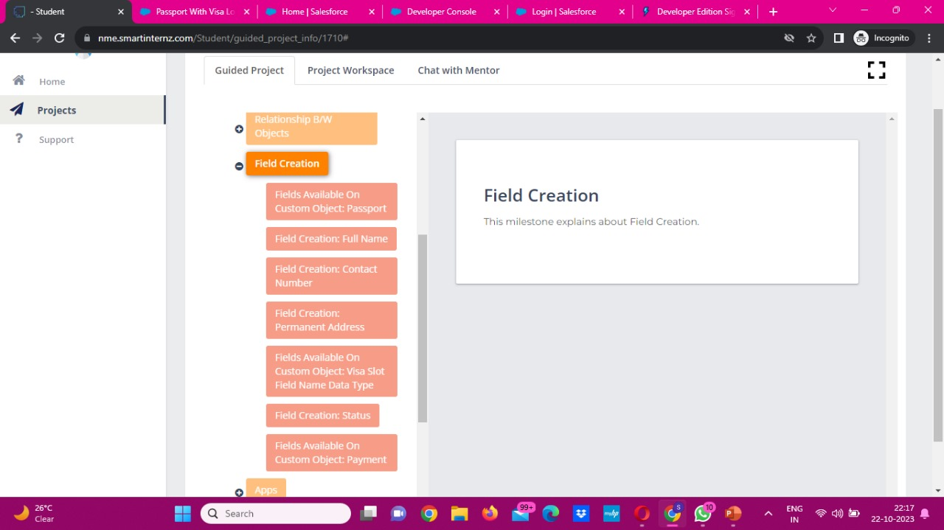
FIELD CREATION
WHAT IS FIELD CREATION ?
Field creation in Salesforce involves defining data attributes like names, types, and pick lists to store specific information within records .

Slide 12
APPS
Apps in Salesforce are a group of tabs that help the application function by working together as a unit. It has a name, a logo, and a particular set of tabs. The simplest app usually has just two tabs.
There are two types of Salesforce Applications:
Standard Apps
Custom Apps

Slide 13
USER
A user is anyone who logs in to Salesforce. Users are employees at your company, such as sales reps, managers, and IT specialists, who need access to the company's records.
Every user in Salesforce has a user account.

Slide 14
USER ADOPTION
User adoption in Salesforce measures how well users engage with and effectively utilize the platform, impacting its overall success and efficiency

Slide 15
REPORTS
Reports in Salesforce is a list of records that meet a particular criterion which gives an answer to a particular question.
These records are displayed as a table that can be filtered or grouped based on any field.
We have used 2 type of reports
Creation of report
View report

Slide 16
DASHBOARDS
Dashboards in Salesforce are a graphical representation of Reports. It shows data from source reports as visual components. These components provide snapshots of key metrics and performance indicators of the organization at a glimpse.
Reports can be displayed in the dashboard like: Horizontal Bar chart, Vertical Bar Chart, Line Chat, Donut Chart, Metric Chart, Stacked Vertical Bar Chart, Stacked Horizontal Bar Chart, etc.
THEY ARE 2 TYPE OF DASHBOARDS:
Creation of Dashboard
View Dashboards

Slide 17
APEX
Apex is a coding language of Salesforce. It can be invoked or started using triggers.
A trigger is a set of Apex code that runs before or after data manipulation language (DML) events.
They are 2 type Apex Triggers :
Before Triggers
After Triggers

Slide 18
Before triggers:
These are helpful in cases that require a validation process before accepting a change.
They run before any database changes.
After triggers:
These are helpful in cases where you need to modify your database records and when the necessary value is stored in other records.
They run after any database changes.

Slide 19
THANK YOU

